Slide 1
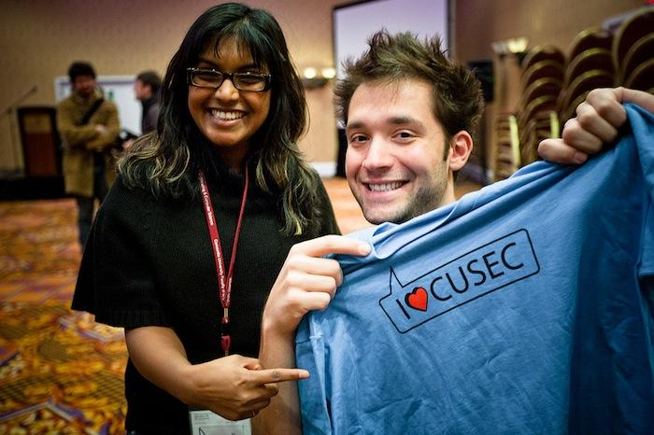
CUSEC 2013
CUSEC 2013

Slide 2
What's CUSEC
Canadian University Software Engineering Conferencebut it's really more about 'computer people'
Student run
Non-profit
Montreal, 16-19 January 2013
Join http://goo.gl/BZ9zz

Slide 3
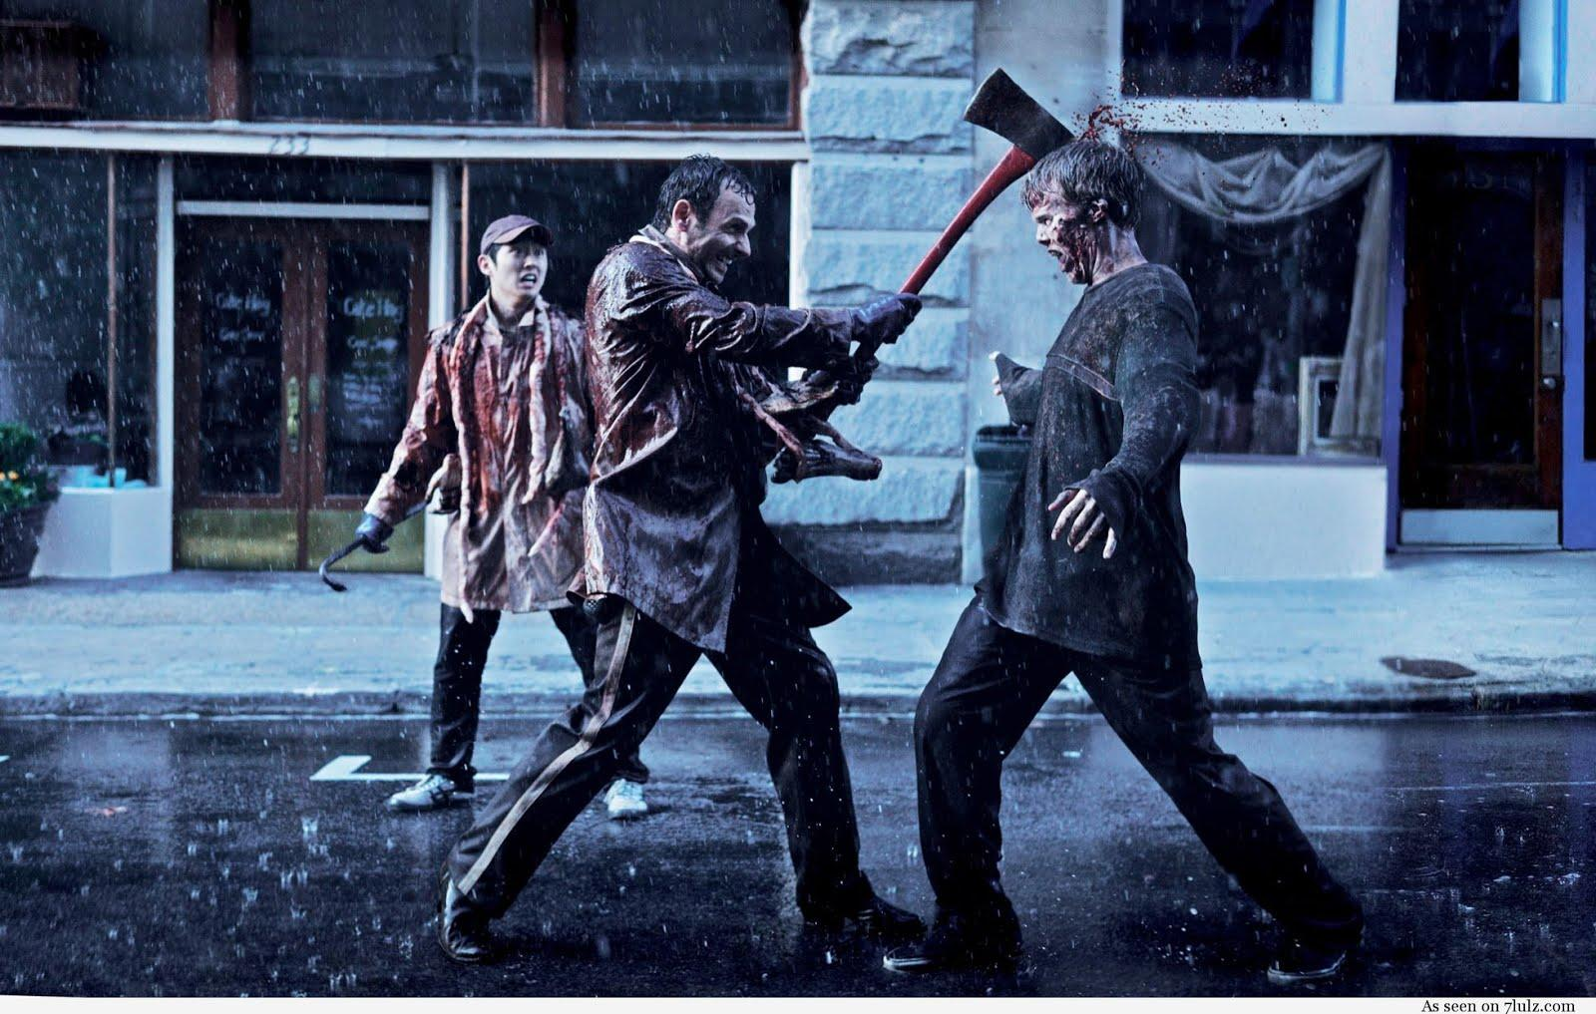
The Speaker Line-up is to die for...
Literally...

Slide 4
Previous years!
Every year, awesome speakers and Great Talks!
Richard Stallman
GNU/Linux
Alexis Ohanian
Reddit
Zed Shaw
Mongrel server / Learn X The Hard Way
Jeff Atwood
StackOverflow / Coding Horror

Slide 5
Confirmed so far for this year includes...
"Data Visualization Expert and Co-Developer of Processing"
Ben Fry
"Cryptographer, cracked Netscape Navigator"
Ian GoldbergJoin http://goo.gl/BZ9zz

Slide 6
and ...
"Ph.D Student from Carleton, thesis in Storytelling in Video Games"
Gail Carmichael
...How cool is that? C'mon, be inspired!
Join http://goo.gl/BZ9zz

Slide 7
Make a friend? Or two? Or three?
Surrounded by over 400 like-minded students from all across Canada!
Evening pub and games night's: sit back, relax and talk a bit of tech (...or not) with peers, sponsors and speakers.
Meet, network and bond with new people that you can add to your professional network! Perhaps personal too :P

Slide 8
Want a job?
Career fair with over 13 tech-industry companies wanting to bring you on their team, it's a fact!
Sponsors include Google, Microsoft, Shopify, SAP, Morgan Stanley, Amazon and many more!

Slide 9
Pourquoi ?!?
The best student-run conference in the industry! Period.
rated 11/10
Famous presenters have said that this is the best conference they've ever attended!
Join http://goo.gl/BZ9zz

Slide 10
How much does it cost?
The ticket + 60$
The hotel + 120$
Sub-total = 180$
Funding* - 180$
Total = 0$
* The first 39 students to get their ticket before Dec 10 will be reimbursed at 100%

Slide 11
How
January 16, 1900h:
Departure
January 17 to 19:
Conference
Januray 19, ~1900h:
Return

Slide 12
So How Can I Go?
Get your ticket at STE 4026!
180$, you'll get reimbursed.
Join the Facebook event: http://goo.gl/BZ9zz
Send me an email!
ottawa@cusec.net

